Slide 1


Introduction to Hydraulics
Learn where and why fluid power is used
and how hydraulic equipment makes things move.
Terminology
Hydraulic engineering is a broad term commonly used in several industries including river flows, fluid process distribution and motion and control.
Fluid power is the term used to describe the use of different fluids to transmit power and drive, move or control equipment.

Slide 2
Introduction to Hydraulics
Expected outcomes
To understand the types of equipment driven by hydraulic fluid power.
To understand how hydraulic fluid power works.
To identify typical components used inside a hydraulic system.

Slide 3
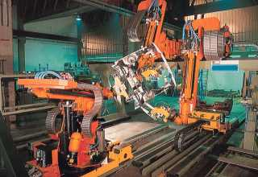

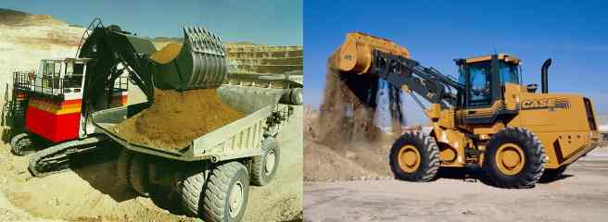
Introduction to Hydraulics
Fluid power hydraulics is used to drive the biggest, most powerful machines in the world. It is used when pneumatic or electrical systems cannot meet the small size, high power, flexibility, control or safety requirements as effectively as a hydraulic system.
Examples
Excavators, cranes, tractors, wind-wave-tidal energy recovery, ship steering and drives, lifting bridges, steel mills, presses, car manufacturing plants, etc.

Slide 4
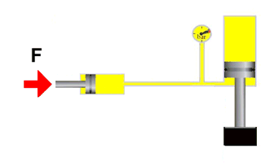
Introduction to Hydraulics
Power is transmitted via the hydraulic fluid
Hydraulic fluid is generally assumed to be incompressible.
Apply a force at one point in a hydraulic circuit and the same force can be used in any other part of the circuit.

Slide 5

Introduction to Hydraulics
A pump supplies the hydraulic fluid
Hydraulic pumps attached to engines or electric motors provide the fluid flow.

Slide 6
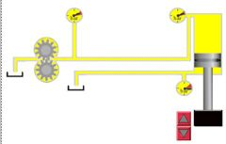
Introduction to Hydraulics
Actuators drive the loads
Hydraulic cylinders or motors convert the hydraulic energy to a mechanical movement to drive the loads.

Slide 7
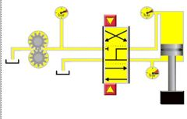
Introduction to Hydraulics
Valves control the fluid direction
To control the direction in which we want the actuator to move we use a directional control valve.

Slide 8
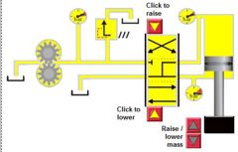
Introduction to Hydraulics
Pressure relief valve provides safety protection
The pressure relief valve open to limit the pressure if the load accidentally exceeds the maximum limit of the components.

Slide 9
Introduction to Hydraulics
Simulation Experiments
Practice operating a simple hydraulic circuit.
Simulation at www.e4training.com/hyd_newbie/basic_comp3.php
Comprehension check
Take the online quiz to test upstanding.
Online test at www.e4training.com/hydraulic_test1.php

Slide 10
Introduction to Hydraulics
Summary
Hydraulic fluid power drives the biggest an best motion control solutions.
If you want to work on the most powerful robots, machines or energy recovery systems then consider a job in fluid power industry.

Slide 11
Introduction to Hydraulics
Further activities
For further information on the principles, components or systems see the full training menu and course list at www.e4training.com
More hydraulic circuits at www.e4training.com/hyd_newbie/basic_circ1.php
Fundamental principles www.e4training.com/menuprinciples1.php
This course is part of a series of hydraulic training courses from www.e4training.com. This presentation is provided free to schools and colleges, but all credits and website links must remain.

